Slide 1
Cell Boundaries
Chapter 7

Slide 2
Objectives:
What are the main functions of the cell membrane and the cell wall?
What happens during diffusion?
What is osmosis?

Slide 3
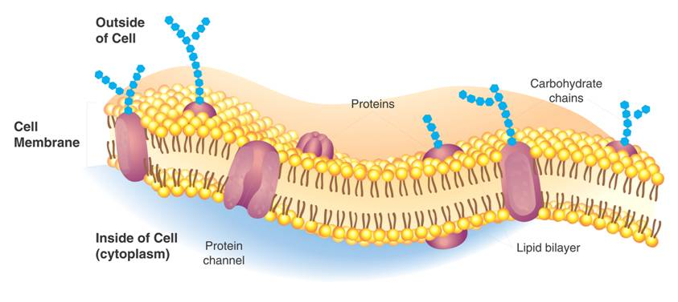
Structure: Cell Membrane
Function: Regulates what enters and leaves the cell Protection Support

Slide 4
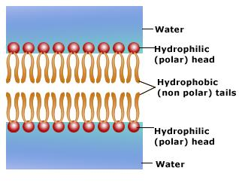
The composition of nearly all cell membranes is a double-layered sheet called a lipid bilayer.
VERY IMPORTANT!
Draw and Write this down!
HydroPHILIC : Water LOVING
HydroPHOBIC: Water FEARING

Slide 5
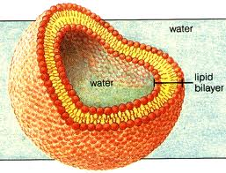
Cell with Lipid Bilayer
What would you find inside the cell?

Slide 6
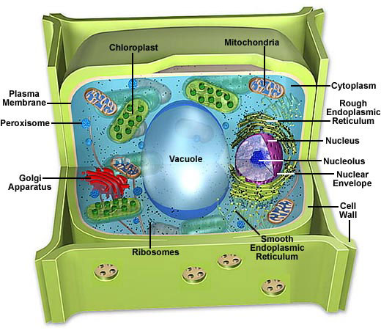
Structure: Cell Wall
Cell walls are found in plants, algae, fungi and many prokaryotes
Cell wall is outside of the cell membrane

Slide 7
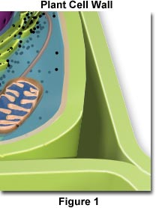
Function:
Allow water, oxygen, carbon dioxide, and certain other substances to pass through easily.
The main function of the cell wall is to provide support and protection for the cell.

Slide 8
How do molecules get in and out of the cell?
One of the MOST important functions of the cell membrane is to regulate the movement of dissolved molecules from the liquid on one side of the membrane to the liquid on the other side of the membrane.

Slide 9
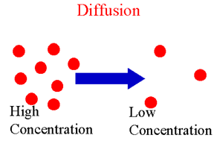
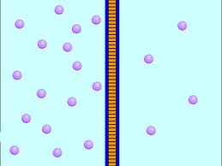
Diffusion
Diffusion: the movement of particles from an area of HIGH concentration to an area of LOW concentration.
CELL

Slide 10
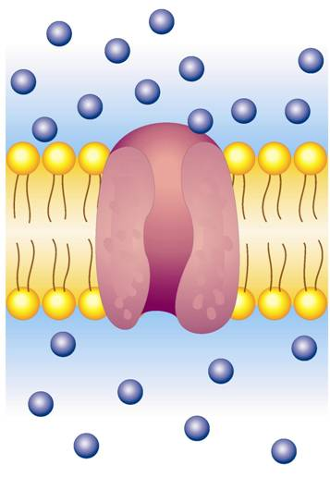
Diffusion
Glucose molecules
DOES NOT REQUIRE ENERGY.
Protein channel

Slide 11
Diffusion
No energy required!
Because diffusion depends upon random particle movements, substances diffuse across membranes without requiring the cell to use energy.

Slide 12
Important Terms
Solute: A solute is the substance to be dissolved ( ex: sugar).
Solvent: The solvent is the one doing the dissolving ( ex: water).
What is another example?

Slide 13
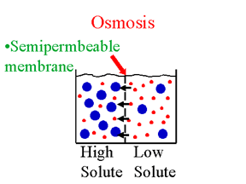
Osmosis
Osmosis is the diffusion of water through a selectively permeable membrane.
High Concentration
to Low Concentration

Slide 14
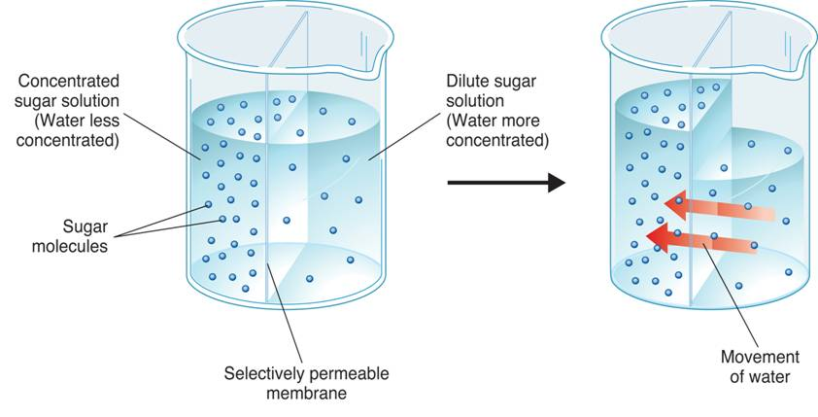
Osmosis

Slide 15
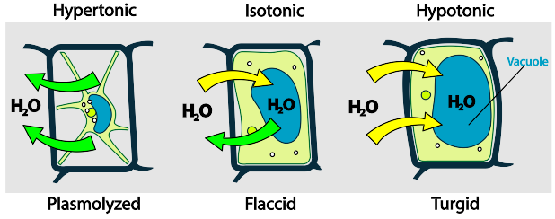
Water will move across the membrane until equilibrium is reached
Hypertonic Solution: More Solute Less Water
Hypotonic Solution: Less Solute More Water
dklsfjsldjlsdfsd
More water outside the cell
Wants to move in
More water inside the cell
Wants to move out
Water is balanced
Both inside and outside

Slide 16
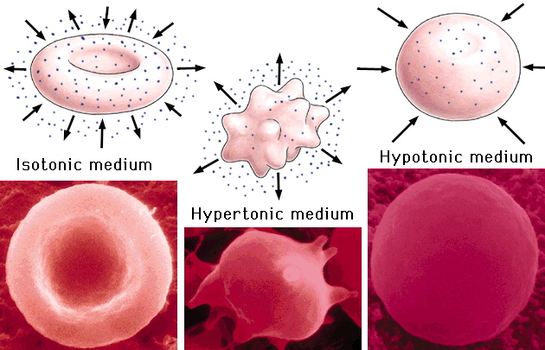
The cell is mostly made up of water. The movement of water can impact the shape of the cell.

Slide 17
Objectives:
What is the difference between passive and active transport?

Slide 18
Passive Transport
Molecules can pass in and out of the cell WITHOUT energy
Examples:
Diffusion
Osmosis
Facilitated Diffusion

Slide 19
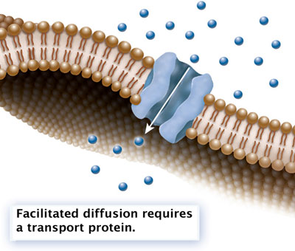
Molecules that are too large cannot just pass through the membrane
Facilitated Diffusion
The cell membrane channels are said to facilitate, or help, the diffusion of large molecules.
High → Low Concentration
Ex: Glucose, Amino Acids

Slide 20
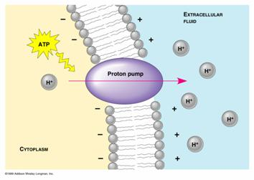
Cells sometimes move materials in opposite direction—against the gradient ( Low → High )
Active Transport
Requires Energy
Low → High Concentration
Ex: Small Molecules, Ions (Na+)
Energy
Needed

Slide 21
Active Transport: Endocytosis and Exocytosis
Too large of materials need to be transported into the cell.
Endocytosis: taking material into the cell by means of infoldings, or pockets, of the cell membrane.
Exocytosis: taking material out of the cell by a membrane that fuses with the cell, forcing contents out.

Slide 22
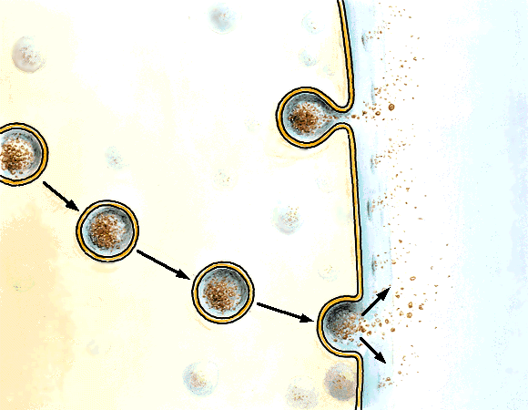
Label this image!

Slide 23
