Slide 1
Chapter 2: Macromolecules
https://www.youtube.com/watch?v=H8WJ2KENlK0

Slide 2
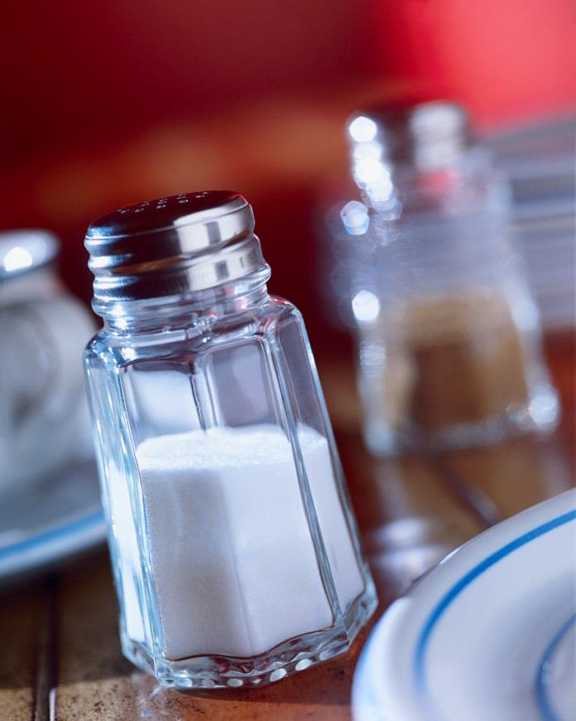
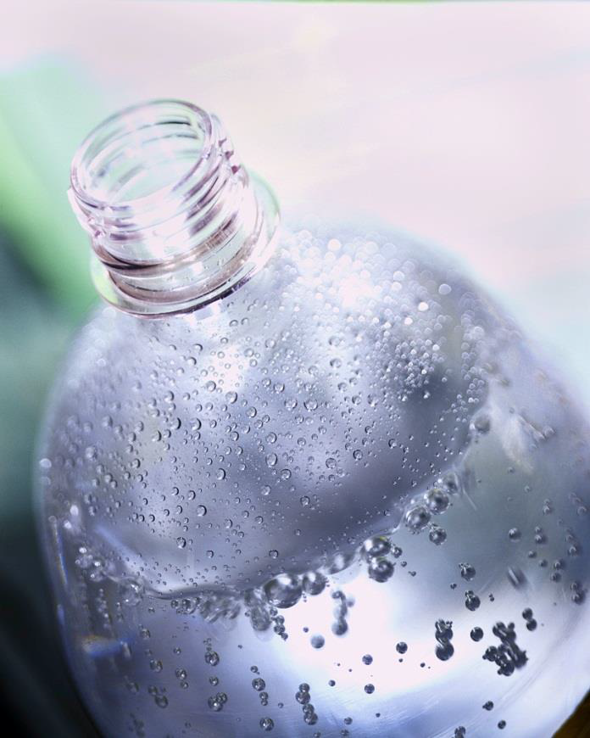
1. Introduction
a. Inorganic compounds are used in nonliving matter non-living matter.
Table Salt
Water

Slide 3
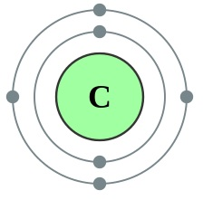
Introduction
b. Organic Molecules contain carbon & hydrogen
Variety of combinations
caused by Carbon having 4 valence electrons.

Slide 4
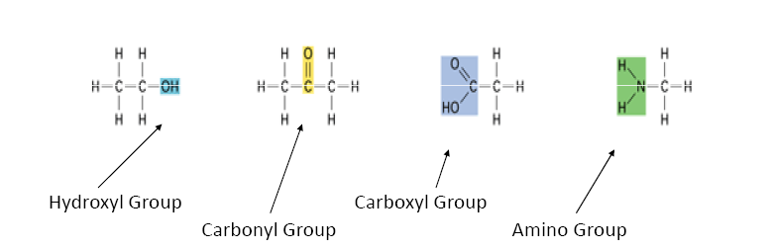
1. Functional group
A group of atoms within a molecule that interacts in a predictable way with other molecules.

Slide 5
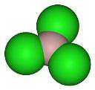
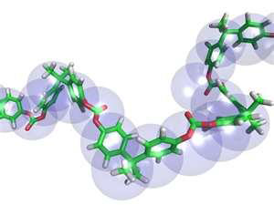
2. Macromolecules
Monomers are small similar molecules used to build larger molecules.
Polymers are large chains of monomers joined together.
Examples:
Carbohydrates
Lipids
Proteins
Nucleic Acids

Slide 6
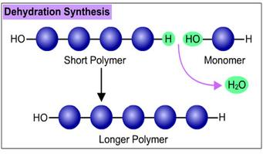
3. Producing a Macromolecule
Dehydration Synthesis
When 2 monomers join together and give off a water

Slide 7
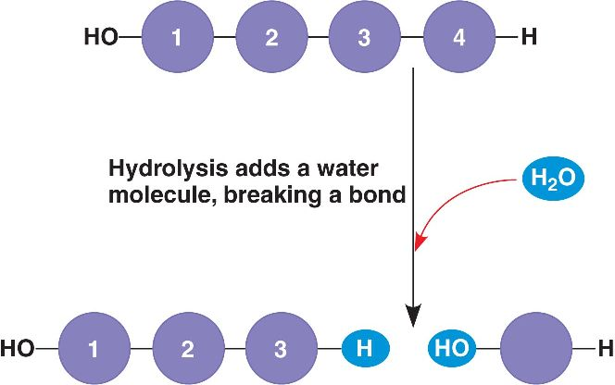
b. Hydrolysis
Process of going from a polymer to a monomer
Add water to a polymer

Slide 8
Carbohydrates
c. Are organic compounds made of sugar.
d. Structurally important in plants, bacteria and insects.
e. Molecular structure is H-C-OH
RATIO – 1C : 2H : 1O

Slide 9
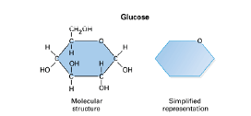
4. Monosaccharides
Single sugars
Building blocks of carbohydrates

Slide 10
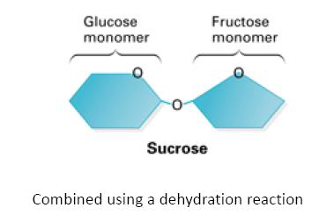
5. Disaccharides
Two monosaccharides joined together using dehydration synthesis

Slide 11
b. Examples
Sucrose – table sugar
Lactose – found in milk
Maltose – used in making root beer

Slide 12
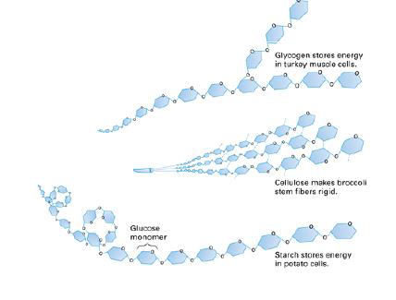
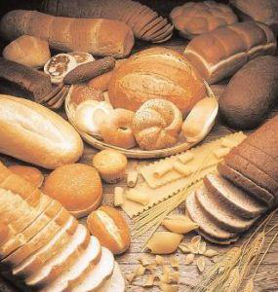
6. Polysaccharides
Long chains of monosaccharides with more nutritional value

Slide 13
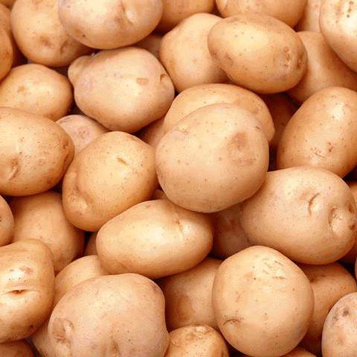
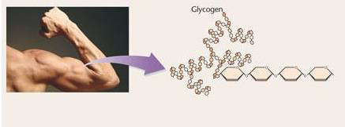
b. How are they stored?
Plants store them in roots and cell walls.
  ex: cellulose
Animals store them as glycogen in muscles.

Slide 14
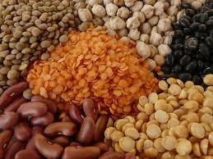
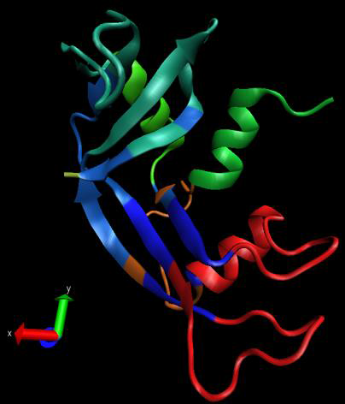
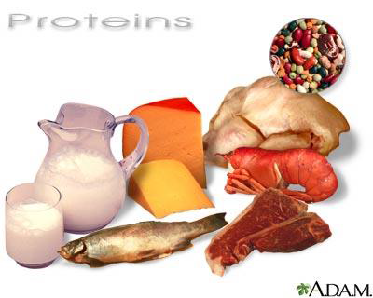
Proteins

Slide 15
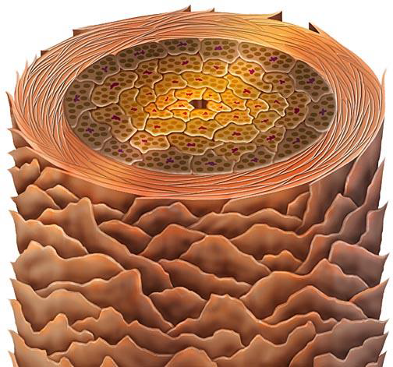
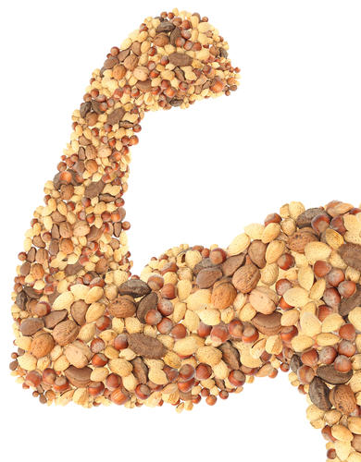
7. General Information
Are large molecules formed by smaller molecules called amino acids
Amino acids building blocks of proteins
Hair strand

Slide 16
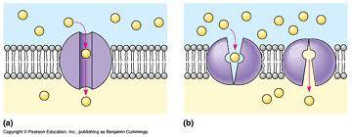
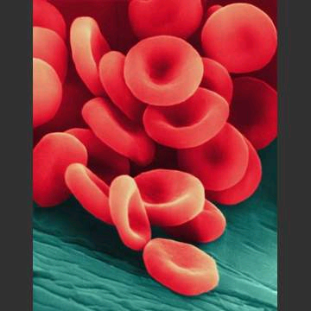
8. Functions
Proteins are in cells for transport
Some are enzymes which speed up reactions
Signal hormones
Transport oxygen

Slide 17
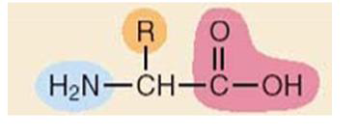
9. Amino Acids
20 different amino acids found in proteins
some are polar and some are non-polar
some are electrically charged and some are not
Proteins fold into complex shapes
General Structure
of amino acids

Slide 18
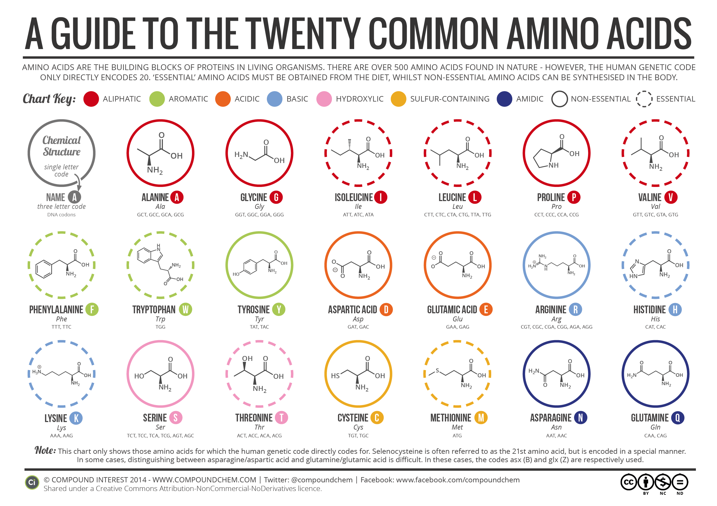

Slide 19
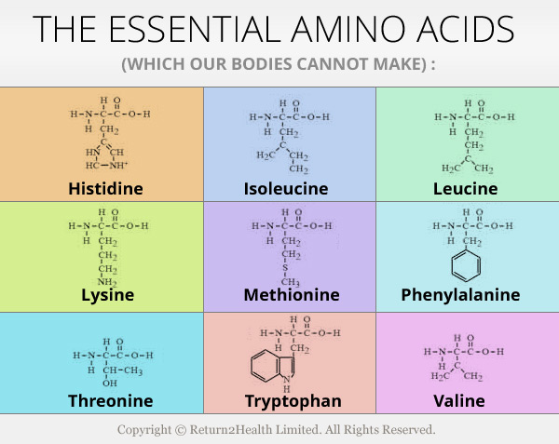

Slide 20
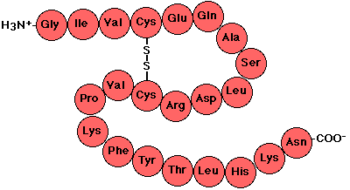
10. Level of Structure in Protein Shapes
a. Primary = unique sequence of amino acids

Slide 21
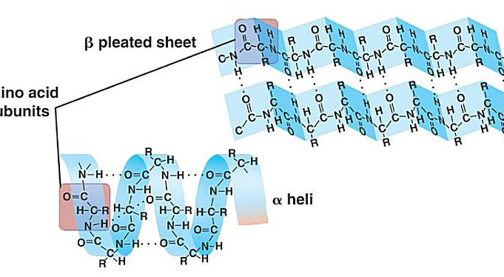
b. Secondary = fold into patterns

Slide 22
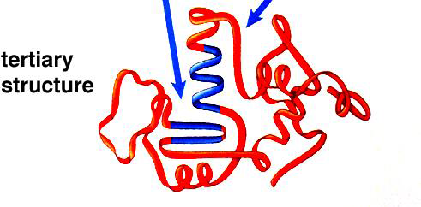
c. Tertiary = 3D shape

Slide 23
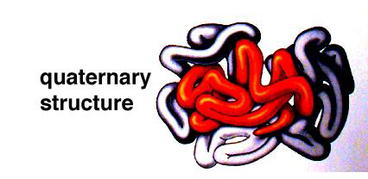
d. Quaternary = combining other proteins

Slide 24
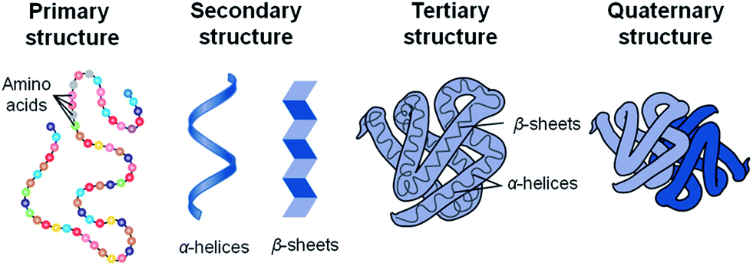

Slide 25
11. Examples
Enzymes = promote chemical reactions
Collagen found in skin, ligaments, tendons and bones
Antibodies = help defend your body against infection
Hemoglobin = a protein that carries oxygen in your blood

Slide 26
12. Enzymes
A chemical reaction is a process that changes one set of chemicals into another set of chemicals.
Involves the changes in chemical bonds
Reactants
Products
The elements and compounds that enter a chemical reaction
The elements and compounds that are produced by
a chemical reaction

Slide 27
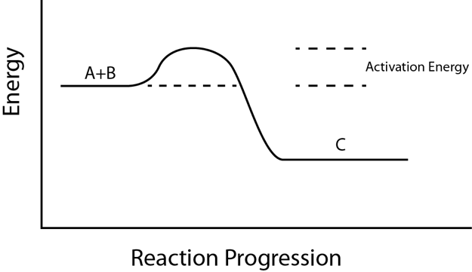
c. Activation energy is the energy needed to get the reaction started
A + B C

Slide 28
d. Chemical reactions that are slow or need a lot of energy are made possible by catalysts.
A catalyst is a substance that speeds up the rate of a chemical reaction.
Catalysts work by lowering a reaction's activation energy.

Slide 29
e. Enzymes are proteins that act as biological catalysts.
f. Enzymes speed up chemical reactions that take place in cells.
g. Enzymes act by lower the activation energy.

Slide 30
How do enzymes work?
Enzymes provide an active site where reactants can be brought together to react, reducing the activation energy needed for reaction.
h. Substrates are the reactants of enzyme-catalyzed reactions.
Substrates Products
Enzyme

Slide 31
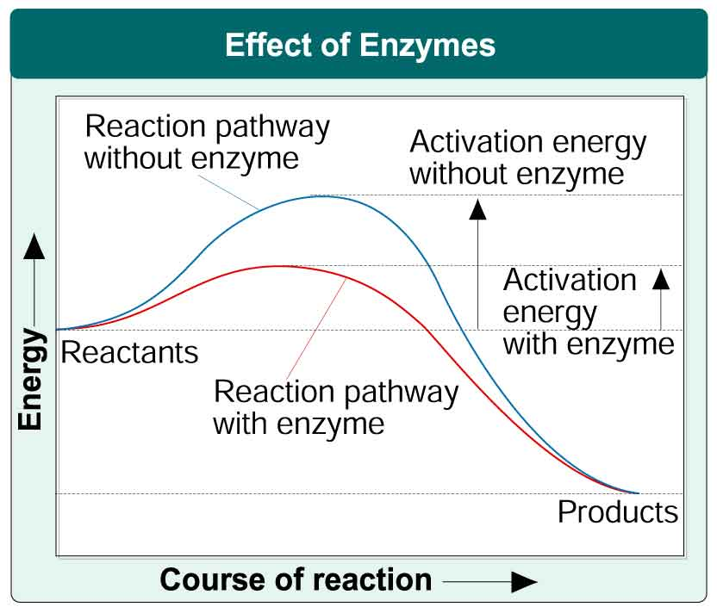

Slide 32
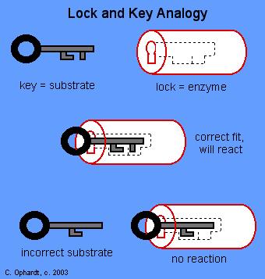
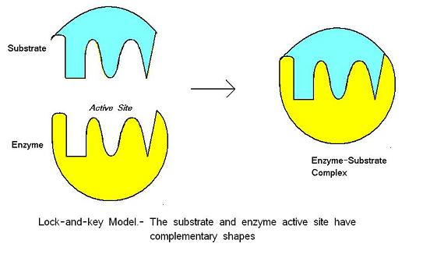
Lock and Key Model

