Slide 1
Chapter 2
Nature of Matter

Slide 2
Why Review?
Chemicals are the raw materials that make up:
Our bodies
The bodies of other organisms
The physical environment

Slide 3
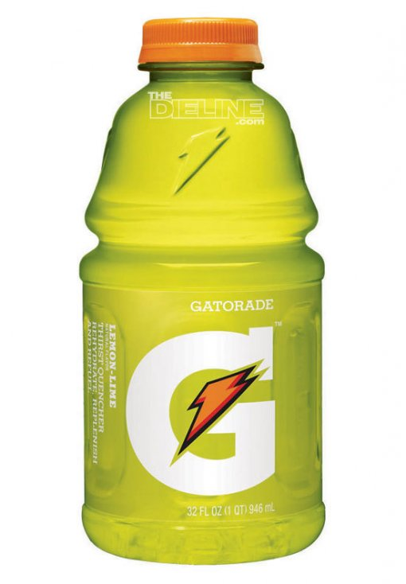
Matter
Matter is a term used to describe anything that has mass and takes up space

Slide 4
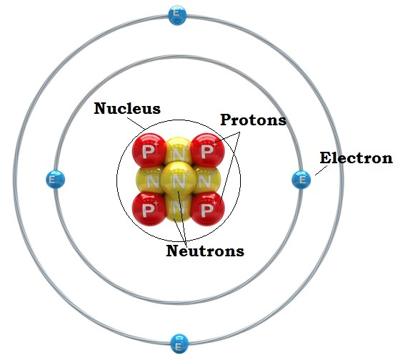
Atoms
Atom is the smallest particle that retains chemical identity of an element
Made up of 3 subatomic parts:
Proton (+ charge)
Electron ( - charge)
Neutron ( 0 charge)

Slide 5
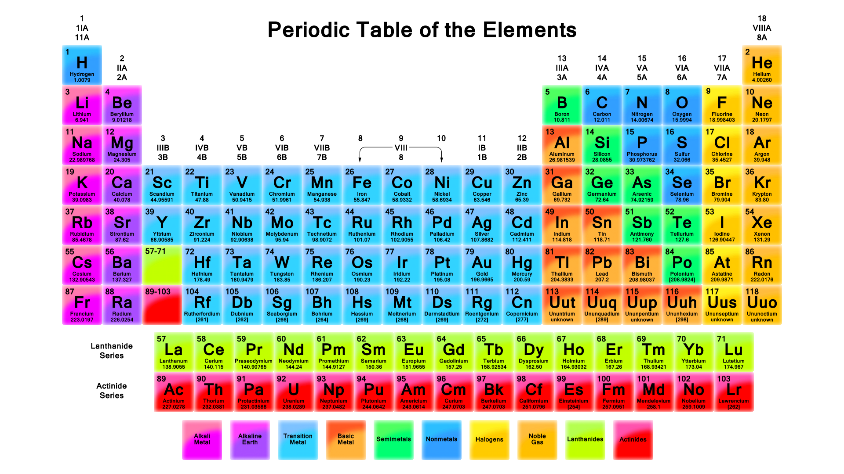
Elements
An element cannot be broken down into another substance by chemical or physical means.

Slide 6
Elements of Life
Four elements make up 96% percent of the weight of most living organisms:
Oxygen
Carbon
Hydrogen
Nitrogen

Slide 7
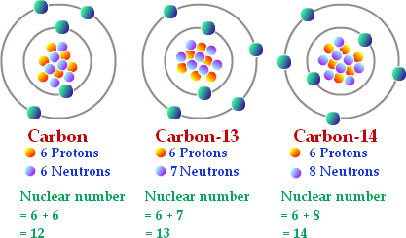
Isotopes
Isotopes are atoms of the same element that have different number of neutrons
If neutrons change, the mass of the atom changes
Mass # = PROTONS + NEUTRONS

Slide 8
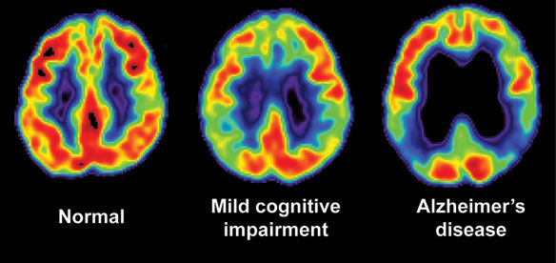
Radioactive Isotopes
Isotopes can be radioactive meaning that their nuclei are unstable and break down at a constant rate over time
Bad because gives off radiation and harm other cells!
Good to help us track cancers or other diseases

Slide 9
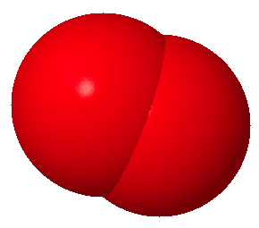
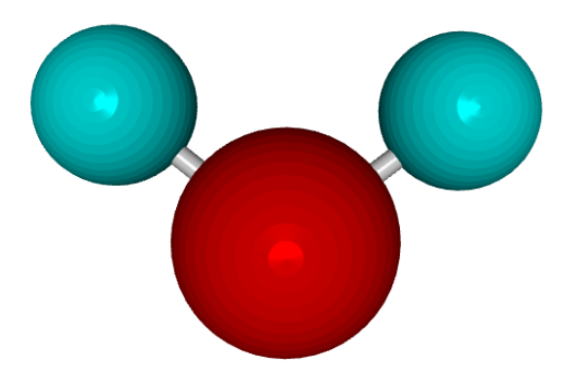
Molecules and Compounds
Molecuel: two or more atoms joined together chemically
Example: Oxygen gas – O2
Compound: two or more different atoms joined together chemically.
Example: Water - H2O

Slide 10
Chemical Bonds
Chemical bonds form when atoms transfer or share electrons
Covalent Bonds – atoms share valence electrons.
Ionic Bonds – atoms transfer valence electrons.

Slide 11
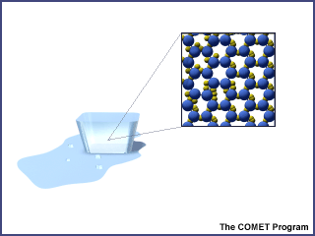
Forces
Van der Waals forces
When molecules are close together, a slight attraction can develop between the oppositely charged regions of nearby molecules.

