Slide 1
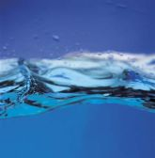
The Extraordinary Properties of Water

Slide 2
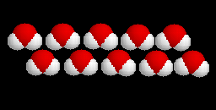
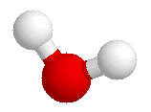
Water
A water molecule (H₂O), is made up of three atoms --- one oxygen and two hydrogen.
H
H
O
Notes:
1

Slide 3
Water is Polar
In each water molecule, the oxygen atom attracts more than its "fair share" of electrons
The oxygen end “acts” negative
The hydrogen end “acts” positive
Causes the water to be POLAR
However, Water is neutral (equal number of e- and p+) --- Zero Net Charge

Slide 4
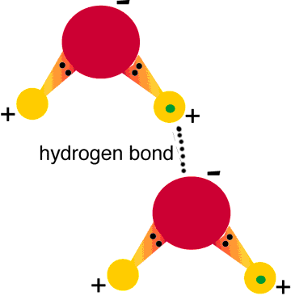
Hydrogen Bonds Exist Between Water Molecules
Formed between a highly Electronegative atom of a polar molecule and a Hydrogen
One hydrogen bond is weak , but many hydrogen bonds are strong

Slide 5
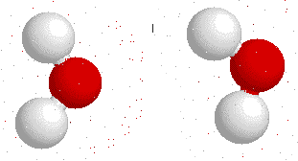
Interaction Between Water Molecules
Negative Oxygen end of one water molecule is attracted to the Positive Hydrogen end of another water molecule to form a HYDROGEN BOND

Slide 6
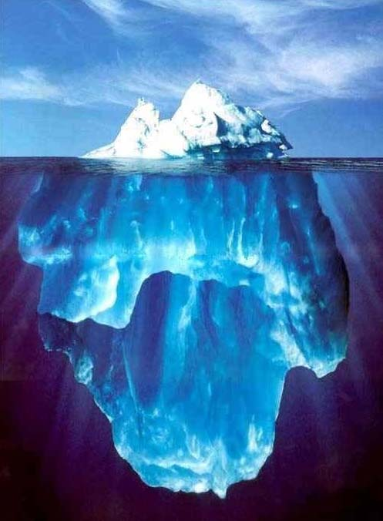
What are the Properties of Water?
Notes:
1

Slide 7
Properties of Water
At sea level, pure water boils at 100 °C and freezes at 0 °C.
The boiling temperature of water decreases at higher elevations (lower atmospheric pressure).
For this reason, an egg will take longer to boil at higher altitudes
Notes:
1

Slide 8
Properties of Water
Cohesion
Notes:
1

Slide 9
Properties of Water
Cohesion
Adhesion
Notes:
1

Slide 10
Properties of Water
Cohesion
Adhesion
High Specific Heat
Notes:
1

Slide 11
Properties of Water
Cohesion
Adhesion
High Specific Heat
High Heat of Vaporization
Notes:
1

Slide 12
Properties of Water
Cohesion
Adhesion
High Specific Heat
High Heat of Vaporization
Less Dense as a Solid
Notes:
1

Slide 13
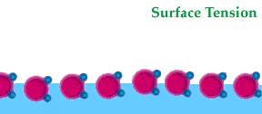
Cohesion
Attraction between particles of the same substance ( why water is attracted to itself)
Results in Surface tension (a measure of the strength of water’s surface)
Produces a surface film on water that allows insects to walk on the surface of water
Notes:
1

Slide 14
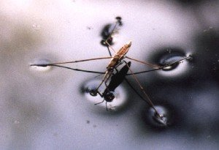
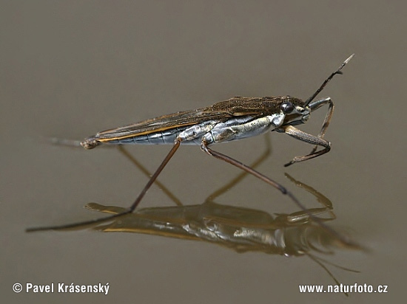
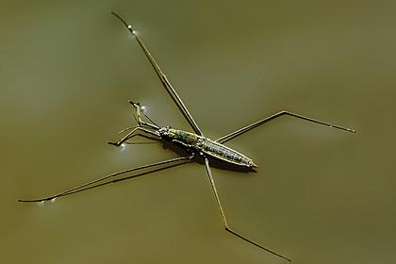
Cohesion …
Helps insects walk across water

Slide 15
Adhesion
Attraction between two different substances.
Water will make hydrogen bonds with other surfaces such as glass, soil, plant tissues, and cotton.
Capillary action-water molecules will “tow” each other along when in a thin glass tube.
Example: transpiration process which plants and trees remove water from the soil, and paper towels soak up water.
Notes:
1

Slide 16
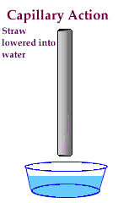
Adhesion Causes Capillary Action
Which gives water the ability to “climb” structures

Slide 17
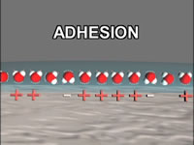
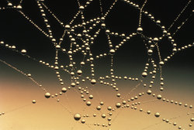
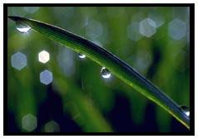
Adhesion Also Causes Water to …
Attach to a silken spider web
Form spheres & hold onto plant leaves

Slide 18
!!!!!STOP!!!!
Under the assignment “Pre-Lab: Molecular Attraction,” click on the Google Form and answer the questions. Once you have completed the google form, you may continue.

Slide 19
High Specific Heat
Amount of heat needed to raise or lower 1g of a substance 1° C.
Water resists temperature change, both for heating and cooling.
Water can absorb or release large amounts of heat energy with little change in actual temperature.
Notes:
1

Slide 20
High Heat of Vaporization
Amount of energy to convert 1g or a substance from a liquid to a gas
In order for water to evaporate, hydrogen bonds must be broken.
As water evaporates, it removes a lot of heat with it.
Notes:
1

Slide 21
High Heat of Vaporization
Water's heat of vaporization is 540 cal/g.
In order for water to evaporate, each gram must GAIN 540 calories (temperature doesn’t change --- 100ºC).
As water evaporates, it removes a lot of heat with it (cooling effect).
Notes:
1

Slide 22
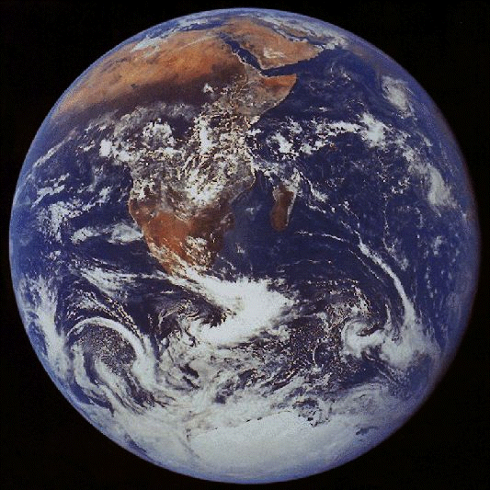
Water vapor forms a kind of global ‘‘blanket” which helps to keep the Earth warm.
Heat radiated from the sun warmed surface of the earth is
absorbed and held
by the vapor.
Notes:
1

Slide 23
Water is Less Dense as a Solid
Ice is less dense as a solid than as a liquid (ice floats)
Liquid water has hydrogen bonds that are constantly being broken and reformed.
Frozen water forms a crystal-like lattice whereby molecules are set at fixed distances.
Notes:
1

Slide 24
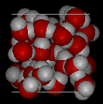
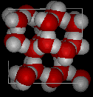
Water is Less Dense as a Solid
Which is ice and which is water?
Notes:
1

Slide 25
Water is Less Dense as a Solid
Water
Ice
Notes:
1

Slide 26
Homeostasis
Ability to maintain a steady state despite changing conditions
Water is important to this process because:
a. Makes a good insulator
b. Resists temperature change
c. Universal solvent
d. Coolant
e. Ice protects against temperature extremes (insulates frozen lakes)
Notes:
4

Slide 27
Solutions & Suspensions
Water is usually part of a mixture.
There are two types of mixtures:
Solutions
Suspensions
Notes:
27

Slide 28
Solution
Ionic compounds disperse as ions in water
Evenly distributed
SOLUTE
Substance that is being dissolved
SOLVENT
Substance into which the solute dissolves
Notes:
28

Slide 29
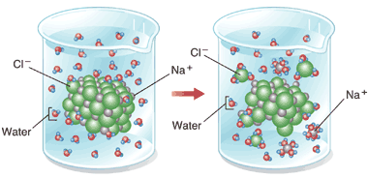
Solution
Notes:
29

Slide 30
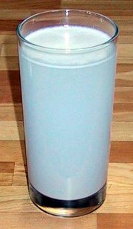
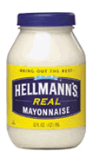
Suspensions
Substances that don’t dissolve but separate into tiny pieces.
Water keeps the pieces suspended so they don’t settle out.
Notes:
30

Slide 31
Acids, Bases and pH
One water molecule in 550 million naturally dissociates into a Hydrogen Ion (H+) and a Hydroxide Ion (OH-)
Hydrogen Ion Hydroxide Ion
Acid Base
H₂O  H⁺ + OH⁻
Notes:
31

Slide 32
The pH Scale
Indicates the concentration of H⁺ ions
Ranges from 0 – 14
pH of 7 is neutral
pH 0 up to 7 is acid … H⁺
pH above 7 – 14 is basic… OH⁻
Each pH unit represents a factor of 10X change in concentration
pH 3 is 10 x 10 x 10 (1000) stronger than a pH of 6
Notes:
32

Slide 33
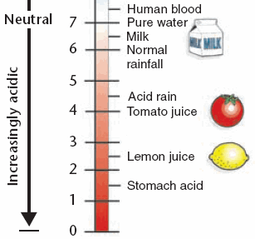
Acids
Strong Acids have a pH of 1-3
Produce lots of H⁺ ions
Notes:
33

Slide 34
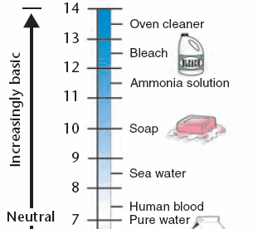
Bases
Strong Bases have a pH of 11 to 14
Contain lots of OH⁻ions and fewer H+ ions
Notes:
34

Slide 35
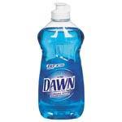
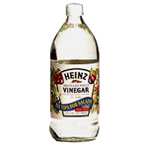
Buffers
Weak acids or bases that react with strong acids or bases to prevent sharp, sudden changes in pH (neutralization).
Produced naturally by the body to maintain homeostasis
Weak Acid
Weak Base
Notes:
35

