Slide 1
Cycles of Matter
Chapter 3 – 3

Slide 2
Biogeochemical Cycles
  Unlike the one-way flow of energy, matter is recycled within and between ecosystems.
  Elements, chemical compounds, and other forms of matter are passed from one organism to another and from one part of the biosphere to another through biogeochemical cycles.

Slide 3
The Four Cycles
Water Cycle
Carbon Cycle
Nitrogen Cycle
Phosphorus Cycle

Slide 4
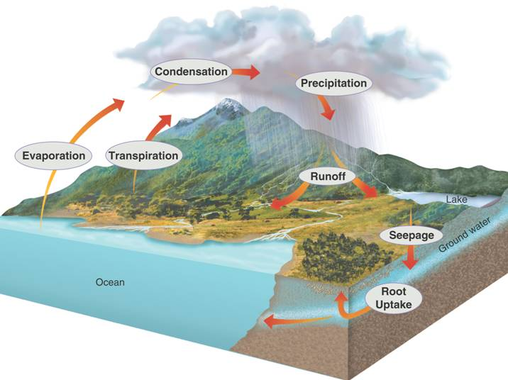

Slide 5
How does water cycle?
Abiotic Sources:
Biotic Sources:

Slide 6
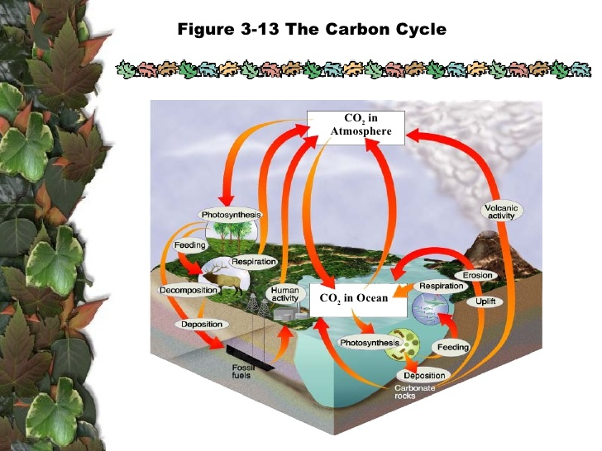

Slide 7
Carbon Cycles
CARBON is a key ingredient of living tissue. (Carbohydrates/Lipids/Proteins/Nucleic Acids)
Biological process, such as PHOTOSYNTHESIS, RESPIRATION, and decomposition, take up and release carbon and oxygen
Geochemical processes such as erosion and volcanic activity, RELEASE carbon dioxide

Slide 8
How does Carbon cycle?
Abiotic Sources:
Biotic Sources:

Slide 9
Nitrogen Cycle
Nitrogen (N) is an essential component of DNA, RNA, and proteins, the building blocks of life.
All organisms require nitrogen to live and grow. Although the majority of the air we breathe is N₂, most of the nitrogen in the atmosphere is unavailable for use by organisms.
N₂ gas must first be converted to more a chemically available form.

Slide 10
Nitrogen fixation is the process wherein N₂ is converted to ammonium, essential because it is the only way that organisms can attain nitrogen directly from the atmosphere.

Slide 11
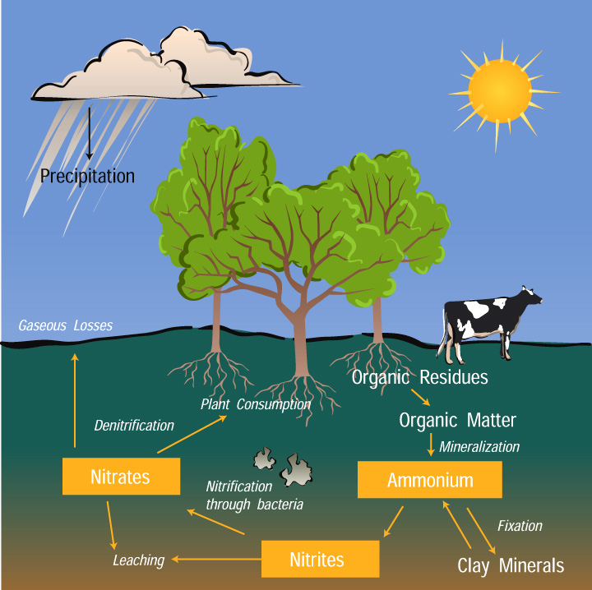

Slide 12
How does nitrogen cycle?
Abiotic Sources:
Biotic Sources:

Slide 13
The Phosphorus Cycle
Important because phosphorus is in DNA and RNA
Not in the atmosphere
Found in soil, and water
Absorbed by plants that then bind it into organic compounds which then are consumed by consumers.

Slide 14
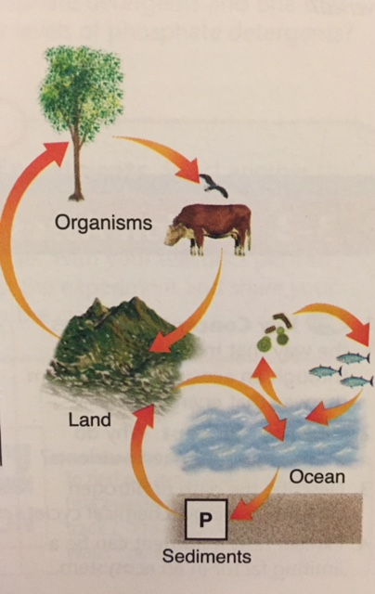

Slide 15
How does phosphorus cycle?
Abiotic Sources:
Biotic Sources:

