Slide 1
Chemical Pathways

Slide 2
Objectives:
What is the energy used by organisms?
How do organisms obtain energy to function in their environment?
Notes:
2

Slide 3
http://www.youtube.com/watch?v=dPKvHrD1eS4
Review!

Slide 4
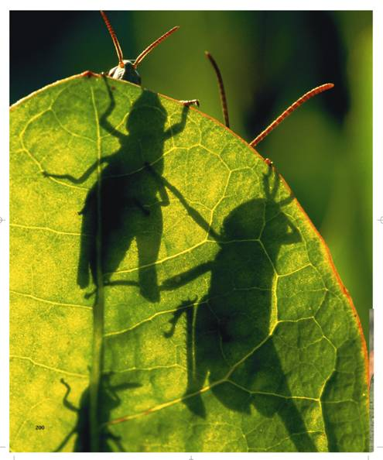
Energy of Life, Photosynthesis, and
Respiration

Slide 5
Energy in Living Things
    Living things need energy to survive.
    Energy comes in many forms including light, heat, electricity, and chemical compounds.

Slide 6
adenosine triphosphate
(ATP)
    ATP, a chemical compound, is used to store and release energy
    It is used by all types of cells as their basic energy source.

Slide 7
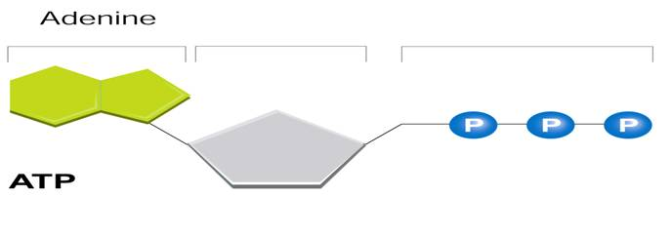
ATP consists of:
      adenine
      ribose (a 5-carbon sugar)
      3 phosphate groups

Slide 8
Energy is released when the bonds that hold the phosphate groups together are broken.
ATP → ADP + P + ENERGY
3 2 1
This released energy is used to power metabolism

Slide 9
Photosynthesis
Photosynthesis is the process in which green plants use the energy of sunlight to convert water and carbon dioxide into high-energy carbohydrates and oxygen.
Occurs in the chloroplasts inside the cell

Slide 10
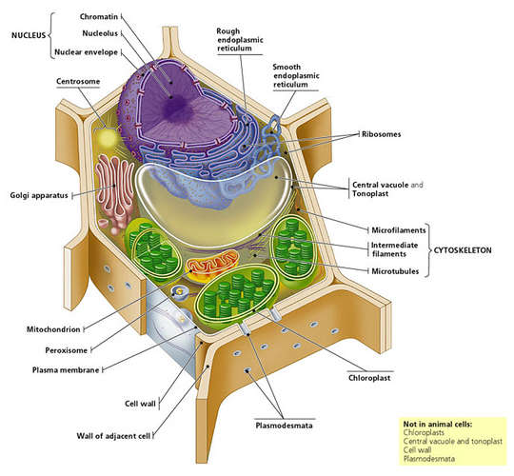

Slide 11
The Photosynthesis Equation
    The equation for photosynthesis is:
    6CO₂ + 6H₂O → C₆H₁₂O₆ + 6O₂
    carbon dioxide + water → sugars + oxygen

Slide 12
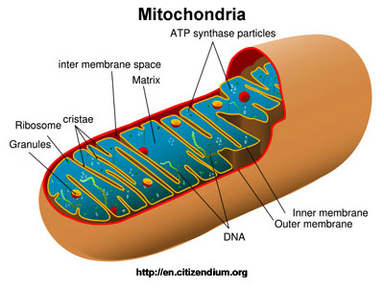
Cellular Respiration
Cellular respiration is the process that releases energy by breaking down glucose and other food molecules in the presence of oxygen.
Both plant and animal cells use cellular respiration to release energy.

Slide 13
Cellular Respiration Equation
    The equation for cellular respiration is:
    6O₂ + C₆H₁₂O₆ → 6CO₂ + 6H₂O + Energy
    oxygen + glucose → carbon dioxide + water + Energy

Slide 14
2 Stages of Photosynthesis
Light Reaction- uses energy from the sun to produce ATP and release O₂
Calvin Cycle (Dark Reaction)- Uses the ATP to produce C₆H₁₂O₆

Slide 15
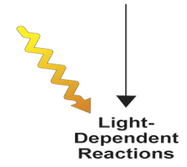

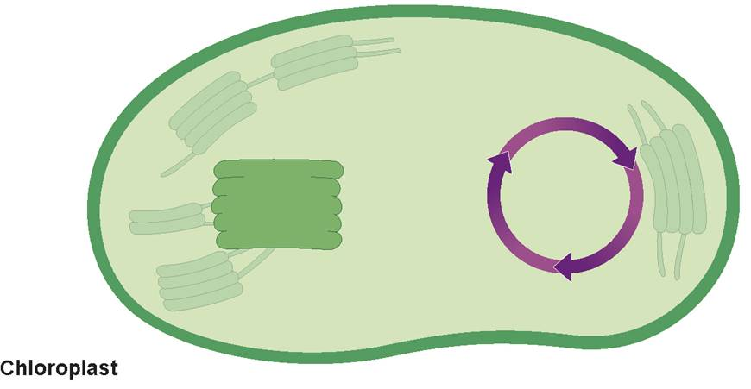







Inside a Chloroplast
H₂O
CO₂
Light
NADP⁺
ADP + P
Light- dependent reactions
Calvin cycle
Calvin Cycle
Chloroplast
O₂
Sugars

Slide 16
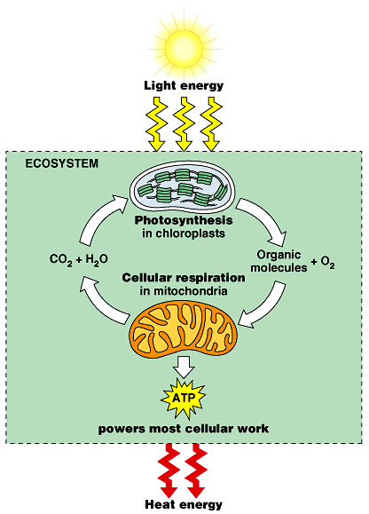

Slide 17
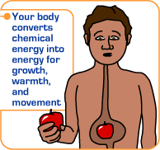
Cellular Respiration:
(2 kinds—Aerobic and Anaerobic)
Cellular respiration is the process by which the energy of glucose is released in the cell to be used for life processes (movement, breathing, blood circulation, etc…)

Slide 18
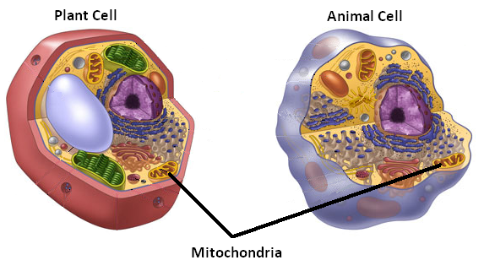
Respiration occurs in ALL cells and can take place either with or without oxygen present.

Slide 19
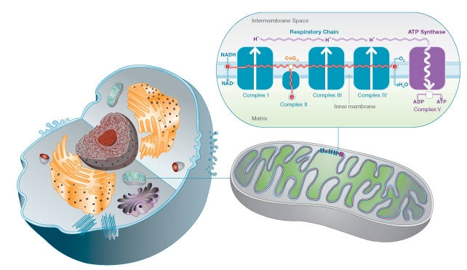
Aerobic Respiration: requires oxygen
Occurs in the mitochondria of the cell
Total of 36 ATP molecules produced
General formula for aerobic respiration:
C₆H₁₂O₆ + 6O₂ 6 CO₂ + 6H₂O + 36 ATP
glucose + oxygen carbon dioxide + water + energy

Slide 20
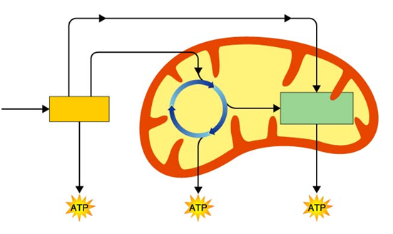
Diagram
Electrons carried in NADH
Mitochondria
In Cytoplasm
Electrons carried in NADH and FADH₂
Krebs Cycle
Glucose
Electron Transport Chain
Glycolysis
2
2
32

Slide 21
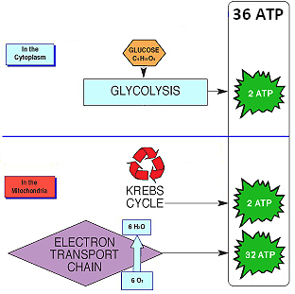
Summary:
3 steps:
1st glycolysis
2nd Krebs cycle
3rd Electron Transport Chain (ETC)

Slide 22
Anaerobic Respiration: occurs when no oxygen is available to the cell (2 kinds: Alcoholic and Lactic Acid)
Also called fermentation
Much less ATP produced than in aerobic respiration

Slide 23
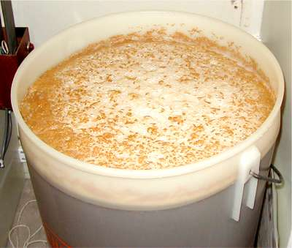
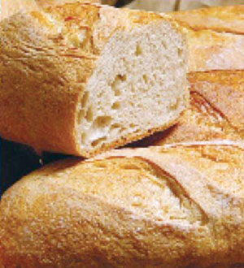
Alcoholic fermentation—occurs in bacteria and yeast
Process used in the baking and brewing industry—yeast produces CO₂ gas during fermentation to make dough rise and give bread its holes
glucose ethyl alcohol + carbon dioxide + 2 ATP
Notes:
23

Slide 24
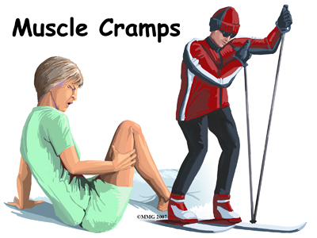
Lactic acid fermentation—occurs in muscle cells
Lactic acid is produced in the muscles during rapid exercise when the body cannot supply enough oxygen to the tissues—causes burning sensation in muscles
glucose lactic acid + carbon dioxide + 2 ATP

Slide 25
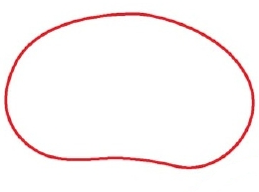
First step in anaerobic respiration is also glycolysis
Diagram
Anaerobic Respiration
Cytoplasm
Alcoholic fermentation
Bacteria, Yeast 2 ATP
C₆H₁₂O₆
glucose
glycolysis
Lactic acid fermentation
Muscle cells 2 ATP
Aerobic Respiration
Krebs Cycle
ETC
36 ATP
Mitochondria

