Slide 1
DNA and Replication
12-1 and 12-2

Slide 2
Objectives
By the end of this mini-unit you will know:
The structure of DNA and its’ function.
What happens during DNA replication.

Slide 3
Short Clip
http://www.youtube.com/watch?v=8kK2zwjRV0M
https://www.youtube.com/watch?v=qy8dk5iS1f0

Slide 4
Short History
Early scientists thought protein was the cell’s hereditary material because it was more complex than DNA
Proteins were composed of 20 different amino acids in long polypeptide chains

Slide 5
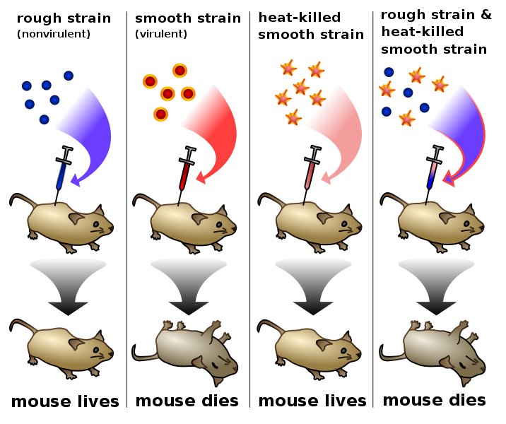
Frederick Griffith, 1928
Looked at how certain
types of bacteria cause
pneumonia
When live and heat-killed
were mixed, some info.
had been transferred
Suggested that
DNA was the genetic
material!!!

Slide 6
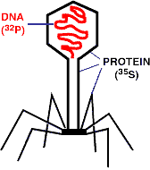
Hershey & Chase, 1952
Experiments on bacteriophage viruses by Hershey & Chase proved that DNA was the cell’s genetic material
both Protein and DNA into this virus
DNA was the only one transferred

Slide 7
DNA
Two strands coiled called a double helix
Sides made of a pentose sugar Deoxyribose bonded to phosphate (PO₄) groups by phosphodiester bonds
Center made of nitrogen bases bonded together by weak hydrogen bonds
7
Notes:
7

Slide 8
DNA Double Helix
“Rungs of ladder”
Nitrogenous
Base (A,T,G or C)
“Legs of ladder”
Phosphate &
Sugar Backbone
8
Notes:
8

Slide 9
DNA
Stands for Deoxyribonucleic acid
Made up of subunits called nucleotides
Nucleotide made of:
1. Phosphate group
2. 5-carbon sugar
3. Nitrogenous base
9
Notes:
9

Slide 10
DNA Nucleotide
Phosphate
Group
O
O=P-O
O
5
CH2
O
N
Nitrogenous base
(A, G, C, or T)
C⁴
C¹
Sugar
(deoxyribose)
C³
C²
10
Notes:
10

Slide 11
DNA
5
O
3
3
O
P
5
P
5
O
G
C
1
2
3
4
4
2
1
3
5
P
O
P
T
A
3
5
O
O
5
P
P
3
11
Notes:
11

Slide 12
Nitrogenous Bases
Double ring PURINES
Adenine (A)
Guanine (G)
Single ring PYRIMIDINES
Thymine (T)
Cytosine (C)
A or G
T or C
Notes:
12

Slide 13
Base-Pairings
Purines only pair with Pyrimidines
Three hydrogen bonds required to bond Guanine & Cytosine
3 H-bonds
G
C
Notes:
13

Slide 14
Two hydrogen bonds are required to bond Adenine & Thymine
T
A
14
Notes:
14

Slide 15
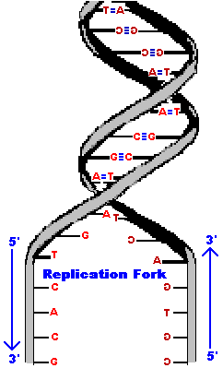
Antiparallel Strands
One strand of DNA goes from 5’ to 3’ (sugars)
The other strand is opposite in direction going 3’ to 5’ (sugars)
Notes:
15

Slide 16
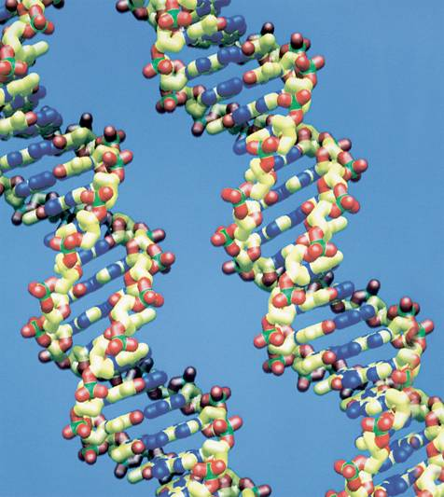
DNA Replication

Slide 17
What happens during DNA replication?
Before a cell divides, it duplicates its DNA in a process called replication. (During the S-phase of Interphase)
Replication ensures that each daughter cell will have a complete set of DNA.
During DNA replication, the DNA molecule separates into two strands, then produces two new complementary strands following the rules of base pairing.
Each strand of the double helix of DNA serves as a template for the new strand.

Slide 18
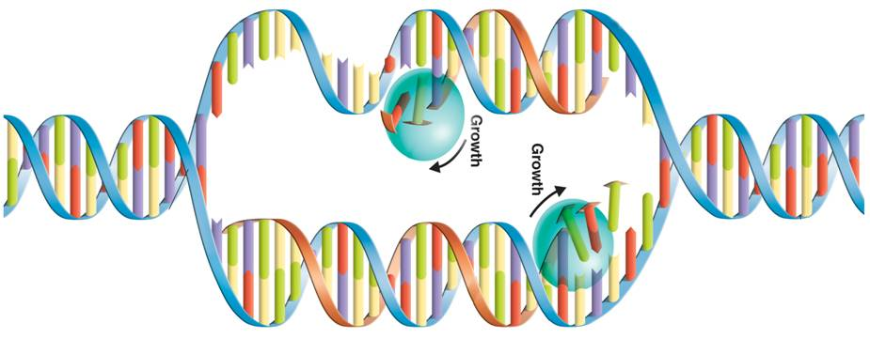
How does replication occur?
New Strand
Original strand
Nitrogen Bases
Replication Fork
Replication Fork
DNA Polymerase

Slide 19
DNA Replication
Two original DNA strands separate
DNA helicase – breaks the hydrogen bonds that hold DNA together and unwinds the strands
Complementary nucleotides(A-T, C-G) are added to each strand
DNA polymerase – adds complementary nucleotides to the exposed nitrogen bases and “proofreads”
Two DNA molecules form that are identical to the original

Slide 20
Replication Interactive
See how information in DNA is copied to make new DNA molecules:
Copying the code – replication
http://www.youtube.com/watch?v=zdDkiRw1PdU&feature=related
http://www.youtube.com/watch?v=4jtmOZaIvS0
DNA replication game

Slide 22
Semiconservative Model of Replication
Idea presented by Watson & Crick
The two strands of the parental molecule separate, and each acts as a template for a new complementary strand
New DNA consists of 1 PARENTAL (original) and 1 NEW strand of DNA
DNA Template
Parental DNA
New DNA
22
Notes:
22

Slide 23
Question:
What would be the complementary DNA strand for the following DNA sequence?
DNA 5’-CGTATG-3’
23
Notes:
23

Slide 24
1. DNA
a. is made up of amino acids.
b. is made up of nucleotides.
c. cannot be repaired if it is mutated.
d. all of these describe DNA.

Slide 25
2. What are the 3 parts to a DNA molecule?
a. A gene, an allele, and a trait
b. A sugar, a phosphate, and a nitrogen base
c. Chromosomes and genes
d. An amino acid, a nitrogen base, and a protein

Slide 26
3. Name the 2 pyrimidines and the 2 purines.

Slide 27
4. Why is DNA considered to be like a ladder?
What makes up the rungs (steps)?
What make up the sides?

